Slide 1
Optical communications and data networks (EENGM2001)
Siddarth K Joshi

Slide 2
Overcoming loss
Relay
Amplifier
End
Receiver
Electronic
Signal
Transmitter
End
Long latency
Can decode packet header and
Redirect
Latency: The time taken for a “packet” of information to reach the receiver

Slide 3
Optical amplifier
Dopped Fibre Amplifiers
Semiconductor amplifiers
Raman Amplifiers

Slide 4
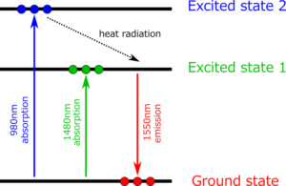
EDFA
Dopped Fibre Amplifier
Erbium-Doped Fibre Amplifier (EDFA)
This is actually a densely packed region of metastable states
Uses stimulated emission
Just like a laser

Slide 5
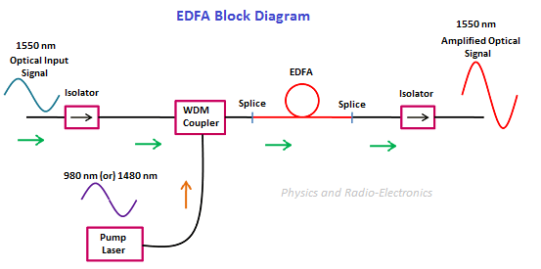
EDFA
Isolators prevent noise

Slide 6
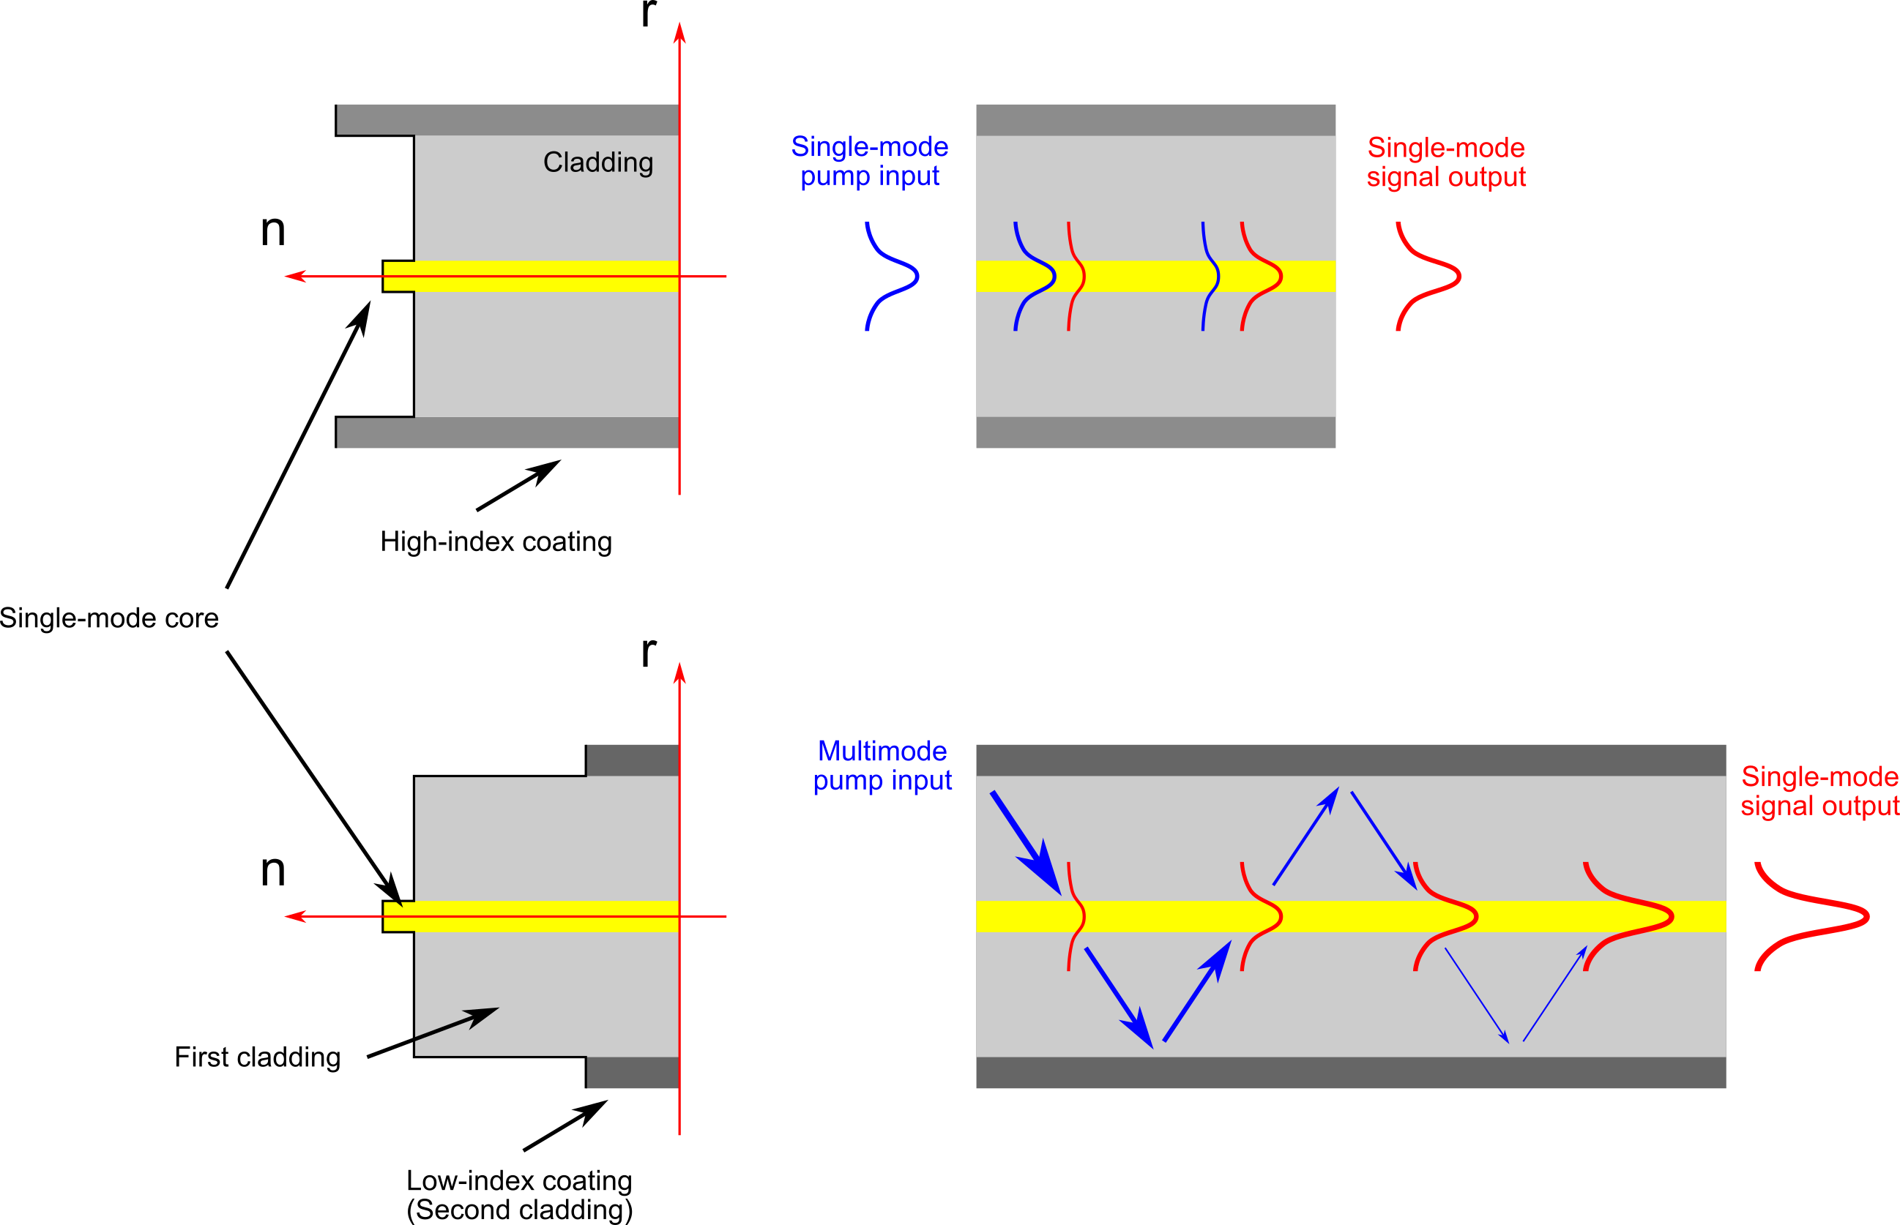
EDFA
Core pumped
Cladding pumped
Short fibre length
Low distortion
Good for ultra short pulses
High gain, High output power
Cheap pump diodes (MM)
Low gain
Expensive
Stronger dispersion effects

Slide 7
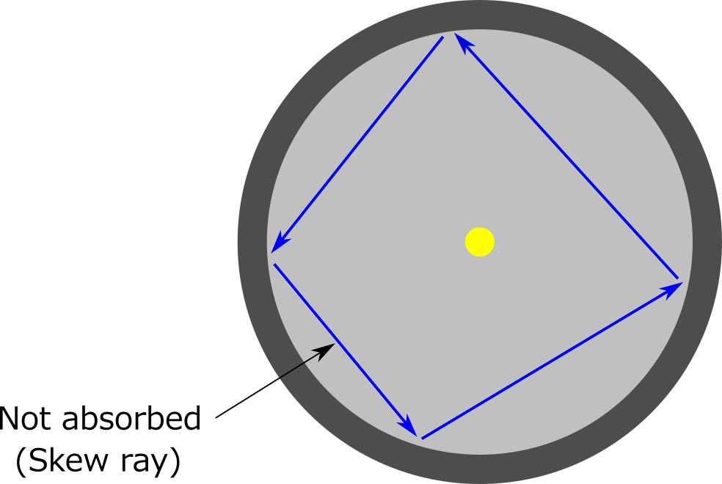
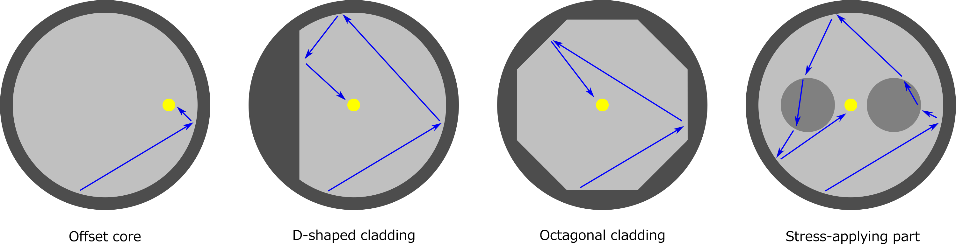
EDFA
Cladding pumped
Need to ensure overlap of pump (in the cladding) and signal (in the core) modes

Slide 8
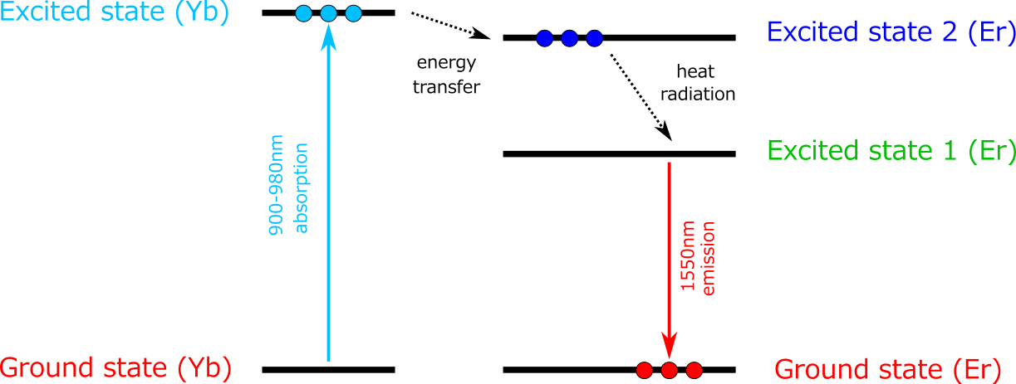
EYDFA
Ytterbium (Yb) is co-doped as a sensitizer
Er > 5000 ppm reduces efficiency
Yb has a wide absorption band
Cheaper since the pump laser is not wavelength stabilised

Slide 9
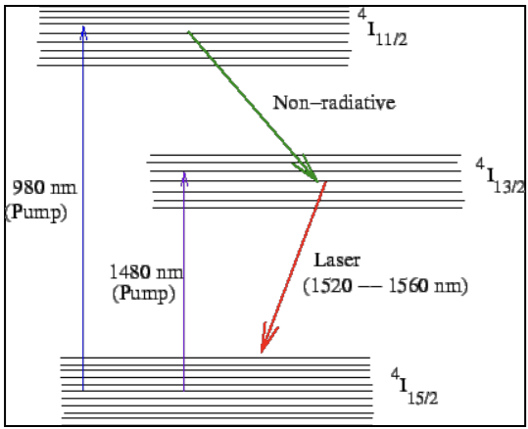
EDFA
More detailed level structure
Each of the earlier levels is actually a set of many
980nm pump more common:
Easy to extract from output
1480nm pump:
Directly excites metastable state
Higher efficiency

Slide 10
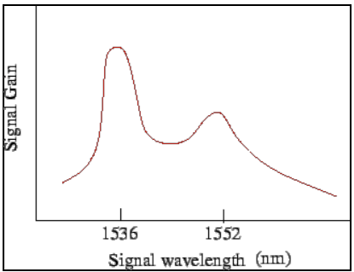
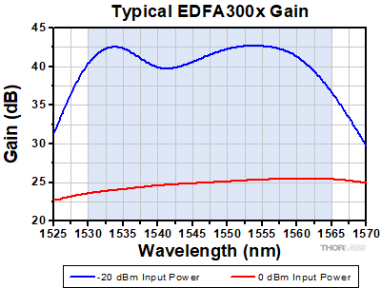
EDFA
If EDFAs need to be chained,
Gain must be flattened.
Typical EDFA gain with Silica fibre
Typical EDFA gain with ZrF₄ fibre

Slide 11
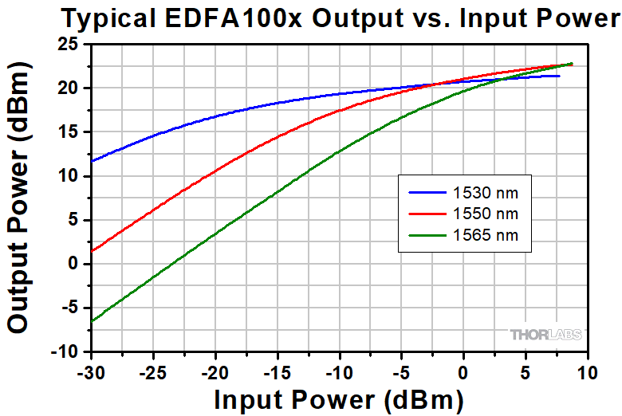
EDFA
Important parameters
Gain
Output saturation power
Max input power
Noise figure

Slide 12
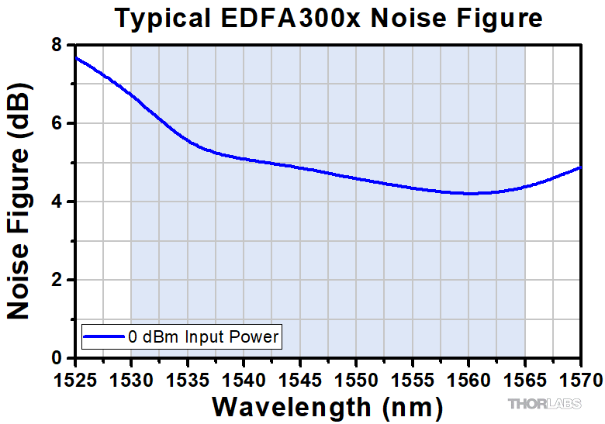
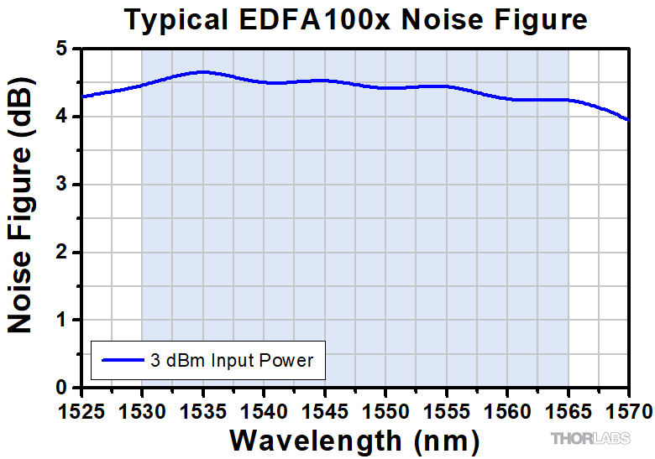

EDFA
Noise Figure = $\frac{SNRinput}{SNRoutput}$
If the amplifier is below saturation, why is the SNR not constant?
For an answer in dB convert the ratio to dB

Slide 13
EDFA
Amplified Spontaneous Emission:
High gain e⁻ mostly in excited state
Probability for high spontaneous decay is large
Each spontaneous photon can be further amplified by the EDFA
Quantum limited noise factor = 3dB
980nm pumped noise factor typically ~3.1dB
1480nm …. ~4.2dB

Slide 14
EDFA
Problem:
Given a noise factor of 3dB (a theoretically perfect EDFA) and an initial SNR of 30, what is the maximum number of EDFAs that can be chained together before the SNR falls below 1?

Slide 15
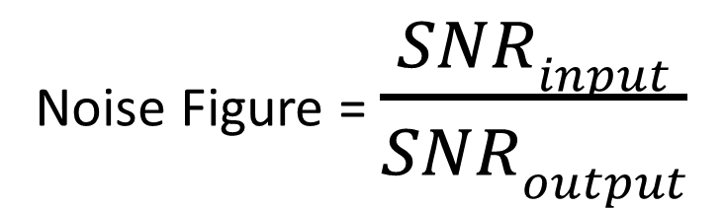
EDFA
Problem:
Given a noise factor of 3dB (a theoretically perfect EDFA) and an initial SNR of 30, what is the maximum number of EDFAs that can be chained together such that the final SNR >=1?
Noise Figure = $\frac{SNRinput}{SNRoutput}$
Final SNR = 1, Initial SNR = 30
Combined Noise figure = 30/1 = 14.7dB
So after 5 EDFAs the SNR is only 0.9, So we can use a max of 4 EDFAs in a chain!

Slide 16
EDFA
Problem:
Given a noise factor of 3.1dB, a saturation output of 20 dBm, a gain of 30dB, a minimum input power of -20 dBm, a fibre loss of 0.2dB/km and an initial SNR of 50. What is the maximum distance of a fibre optic communication link if the receiver has a sensitivity of -40dBm. Assume a BPSK protocol at 1550nm.
Hint: don’t forget the max transmit power through a fibre

Slide 17
EDFA
More information:
E. Desurvire , Erbium Doped Fiber Amplifiers, John Wiley (1994)
C. R. Pollock, Fundamentals of optoelectronics, Irwin (1995)

Slide 18
Overcoming the signal degradation
If EDFAs limit us to a few thousand km how do we build longer links?
Relays!
Convert the signal to electronic, De-code to binary, Re-transmit.

Slide 19
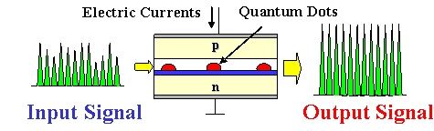

SOA
Semiconductor Optical Amplifier
Like a laser, same gain medium, lower cavity reflectivity
Typically:
Slow, (10MHz, >10ns pulse width)
Electrically pumped
Small & Cheap
Low gain bandwidth
Low gain (< 16dB)
High Noise Figures (>5dB)
Ideal for short distances, urban networks, etc.
https://strathprints.strath.ac.uk/3536/1/JON_SOAs_in_packet_switching.pdf

Slide 20
Raman amplification
Use Stimulated Raman Scattering for amplification
Change the wavelength in the process
Use the fibre length as an amplifier (Distributed amplification)

Slide 21
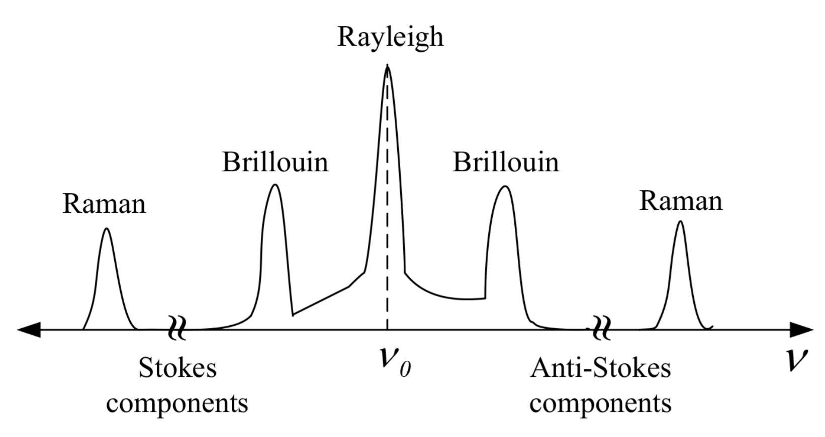
Raman Scattering: Recap
Scattering:
Stimulated Raman
Interaction with vibrational levels of molecules
Isotropic scattering
If transmitting at multiple wavelengths, adds noise to other channels.
Raman shift is typically ~10 THz.
Brillouin shift is about 10 to 500 GHz

Slide 22
Raman Scattering: Correction
Stimulated Raman
Needs strong fields
A strong enough field will make the process directional
Polarisation dependent
Pump and material dependent
Spontaneous Raman
Occurs for low intensities
Is isotropic
Polarisation dependency increases with power until threshold

Slide 23
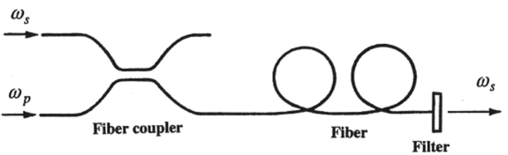
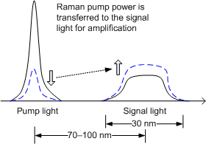
Raman amplification
Energy of pump scattered into energy of signal
High pump powers (> 0.5W)
Signal wavelength does not change

Slide 24
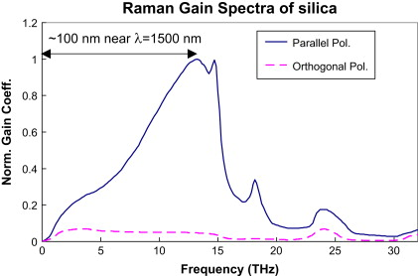
Raman amplification
Peak at 13.2 THz
To amplify light at 1550nm, pump is at 1452 nm (13.2 THz below)
Broad gain width (~6THz or 48nm)
Why is the pump always at a lower wavelength?

Slide 25
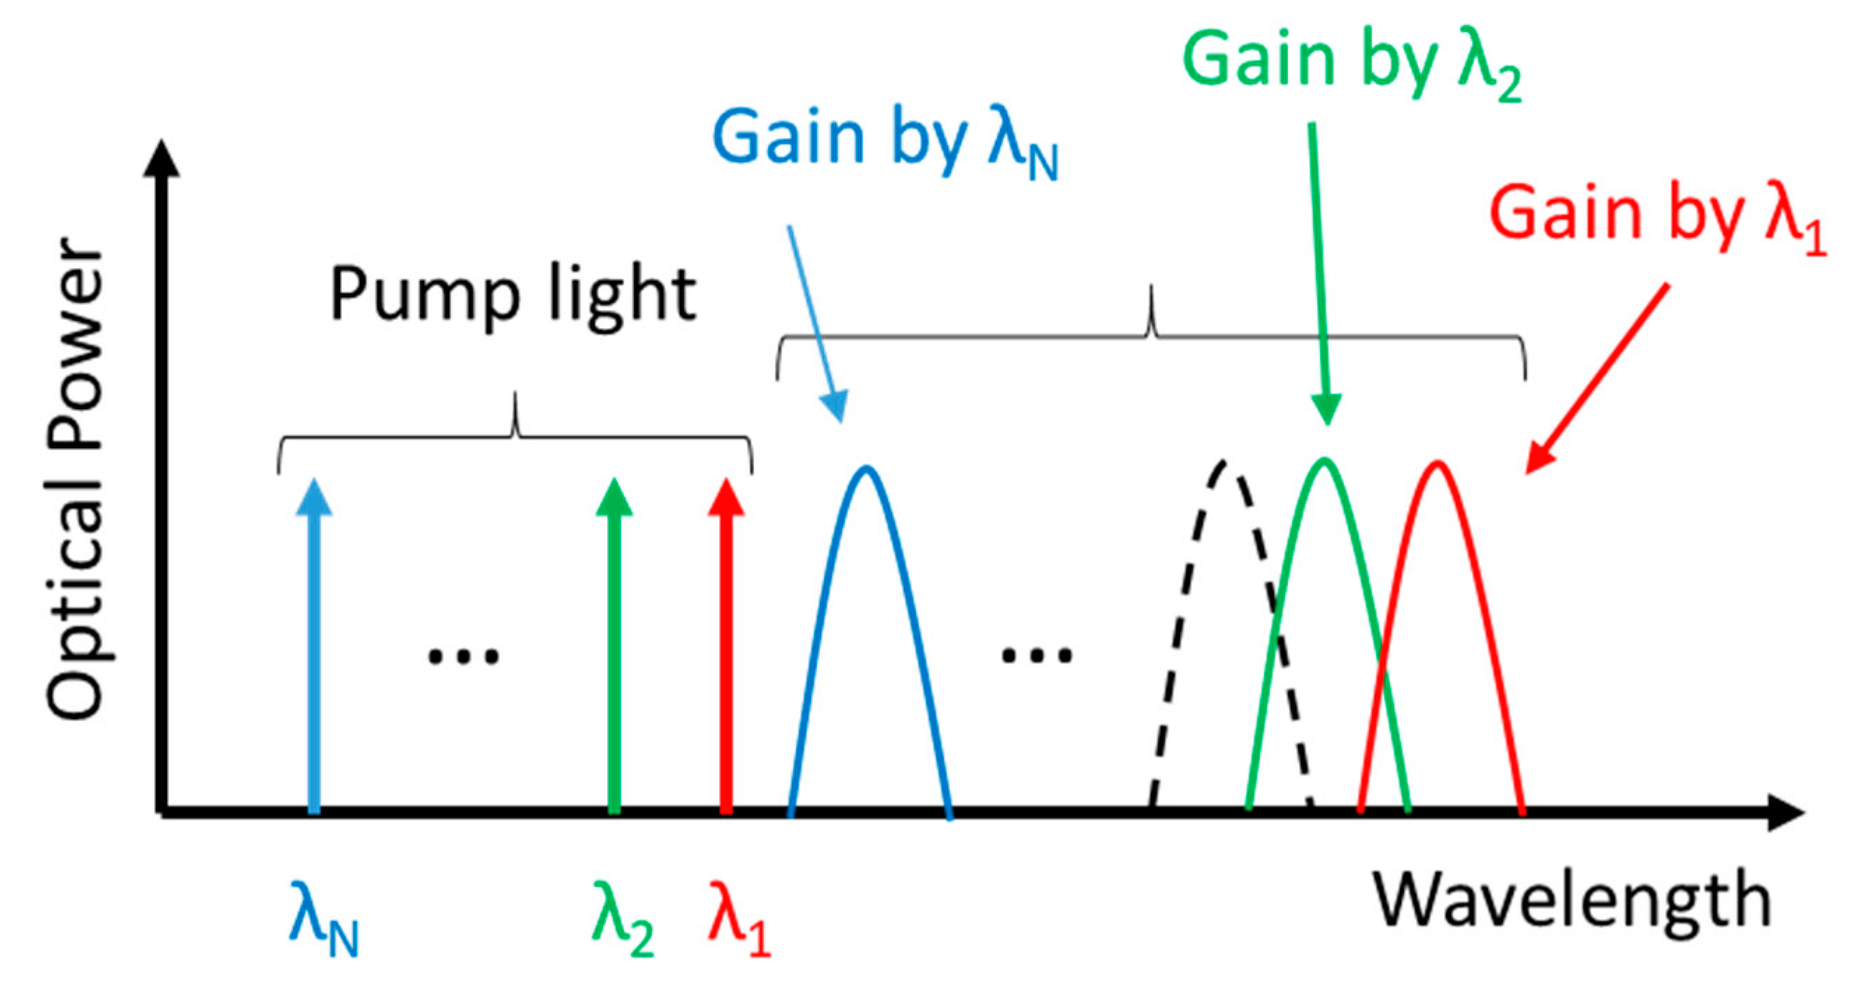
Raman amplification
Use multiple pump wavelengths to increase gain bandwidth

Slide 26
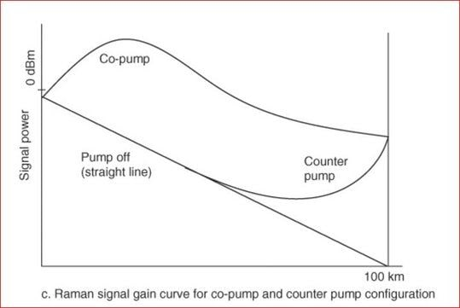
Raman amplification
Counter pump is preferred
Co-Pump can cause excess signal leading to SBS

Slide 27
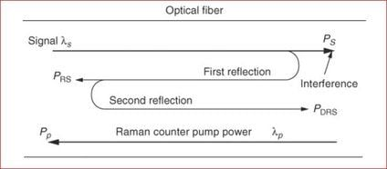
Raman amplification
Noise sources:
Amplified Spontaneous Emissions (ASE)
Double Rayleigh Scattering (DRS)
Pump Laser Noise
Using a Raman amplifier in presence of high reflection can damage equipment
Typically, commercial Raman amplifiers use a test laser before turning on

Slide 28
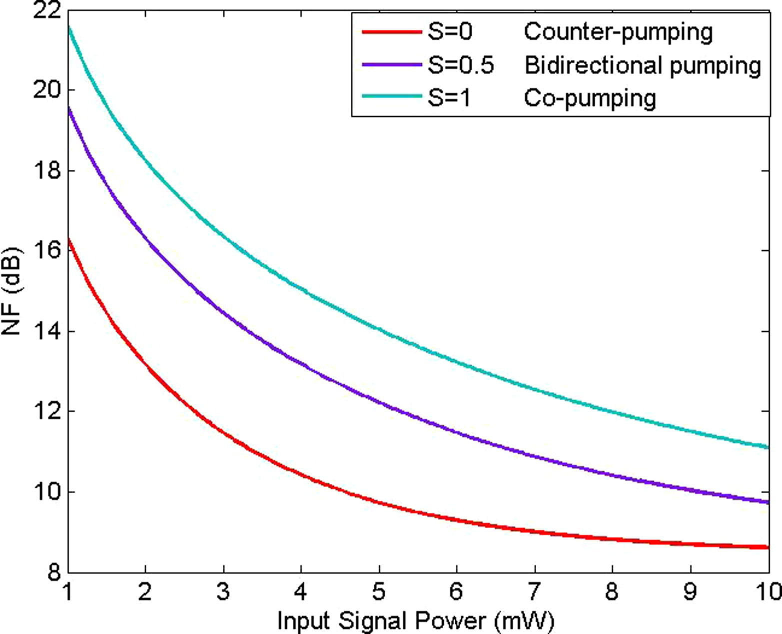
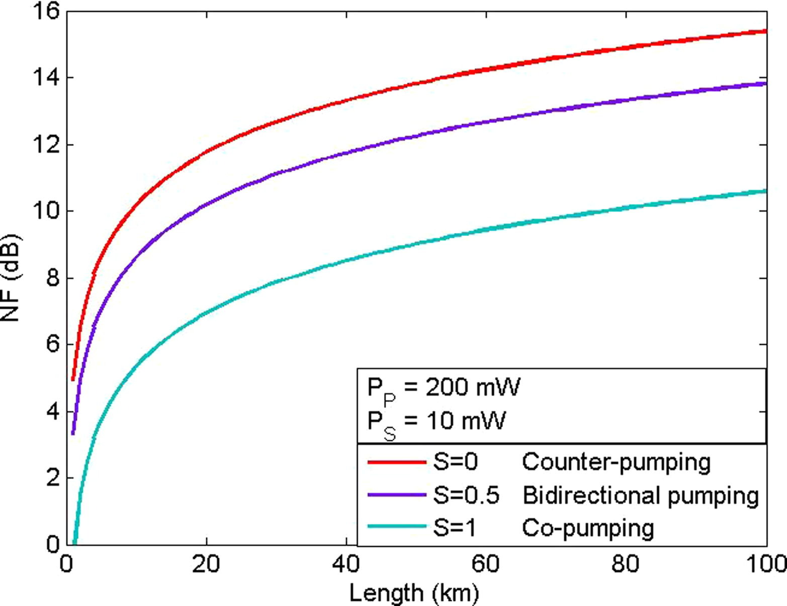
Raman amplification
Noise can be lower than the ASE limit of EDFAs (3dB)
Effective NF = NF of Raman Amp – NF of EDFA = -1dB Typically
https://www.sciencedirect.com/science/article/pii/S1110016820303501

Slide 29
Optical amplification
Raman Amplifier
EDFA
Low gain ( <~20dB)
Expensive
Low Noise
Used to extend total span distances
Rarely used alone (Typically with an EDFA)
EDFA gain up to ~40dB
Impose limit on total span distances

Slide 30
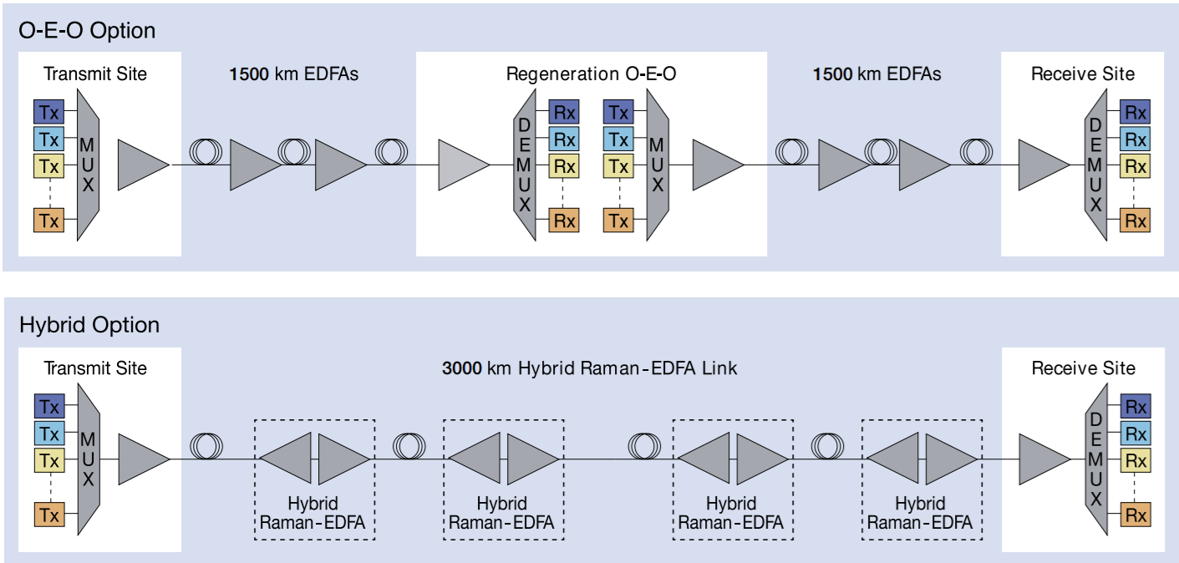
Hybrid Raman & EDFA

Slide 31
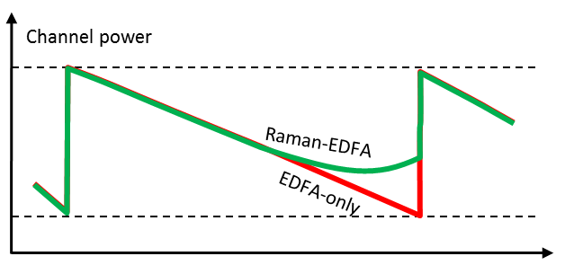
Hybrid Raman & EDFA

Slide 32
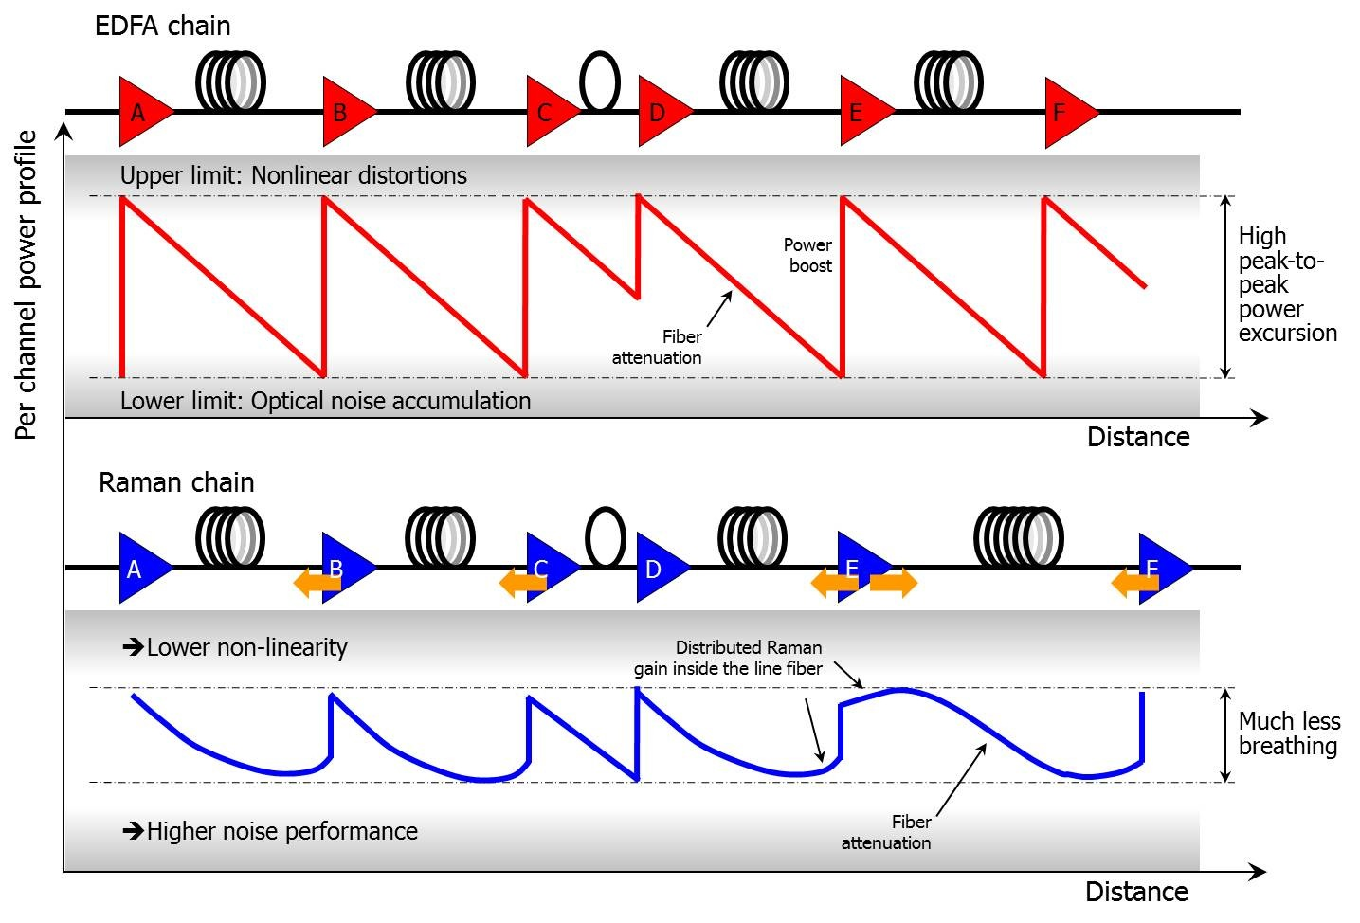
Raman amplification
E.g. Raman amplifiers used to demonstrate 64 Tbps link!
http://www.gazettabyte.com/home/2014/2/5/xtera-demonstrates-40-terabit-using-raman-amplification.html

Slide 33
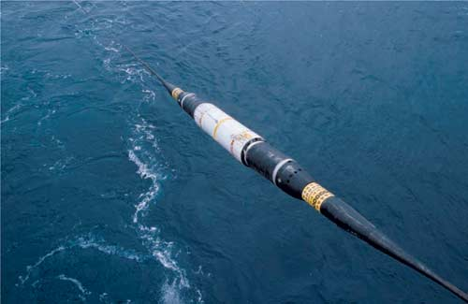
Undersea fibre optics
Extensive use of Raman amps & EDFAs
Multiple redundancies for pump lasers in each module
Repeaters every 60 to 100 Km
Longer the link closer the spacing
Generators on each end maintain a +ve or –ve DC potential of 3 to 15 kV and ~ 20kW

Slide 34
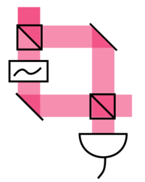
Homodyne detection
Method of phase decoding
Interferometer converts phase changes into intensity fluctuation
Modulated signal in one arm, unmodulated in another
Needs carrier signal
A similar process can convert OOK to BPSK

Slide 35
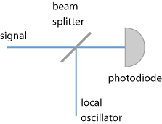
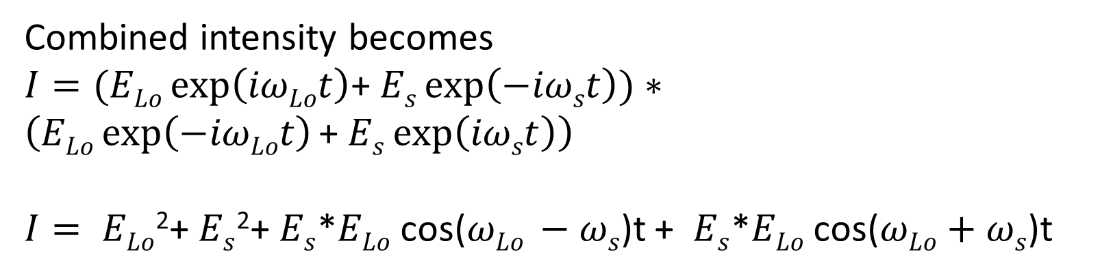
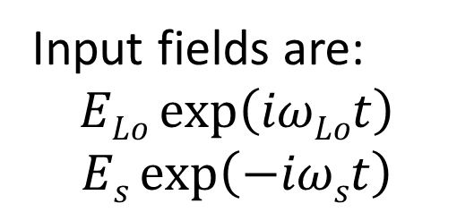
Heterodyne detection
Homodyne = same frequencies
Heterodyne = different frequencies
Can use a different phase stable laser as reference
Combined intensity becomes
$I=(ELo\exp\left(iωLot\right)$+ $Es\exp\left(−iωst\right))∗\left(ELo\exp\left(−iωLot\right)\text{+ }Es\exp\left(iωst\right)\right)$
$I= ELo$²+ $Es$²+ $Es$*𝐸_{𝐿𝑜} cos($ωLo −ωs$)t + $Es$*𝐸_{𝐿𝑜} cos($ωLo+ωs$)t
Input fields are:
$$ELo\exp\left(iωLot\right)$$
$$Es\exp\left(−iωst\right)$$
DC component filtered out
Way too fast, not detected

Slide 36
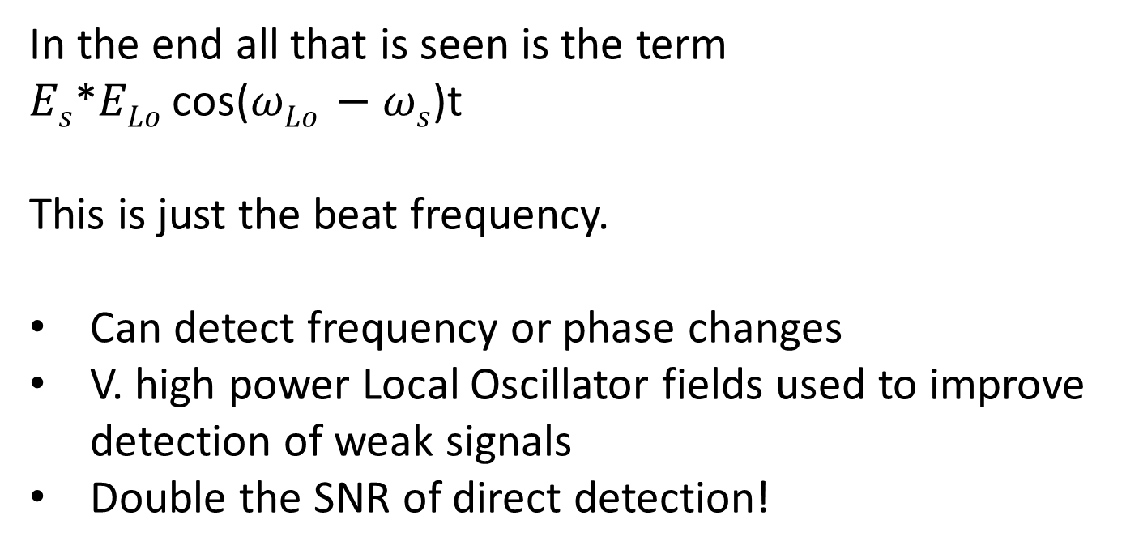
Heterodyne detection
In the end all that is seen is the term
$Es$*𝐸_{𝐿𝑜} cos($ωLo −ωs$)t
This is just the beat frequency.
Can detect frequency or phase changes
V. high power Local Oscillator fields used to improve detection of weak signals
Double the SNR of direct detection!
Input fields are:
$$ELo\exp\left(iωLot\right)$$
$$Es\exp\left(−iωst\right)$$

Slide 37
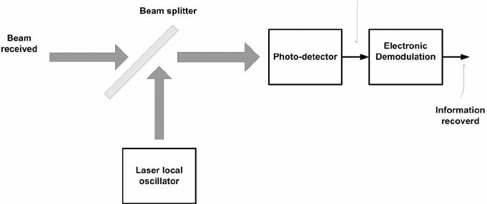
Heterodyne detection
Can be Shot noise limited
If LO is replaced by reference (i.e. carrier wave) then heterodyne becomes homodyne
The BS is commonly 99:1 not 50:50
This improves the signal sensitivity, but needs much higher LO powers.

Slide 38
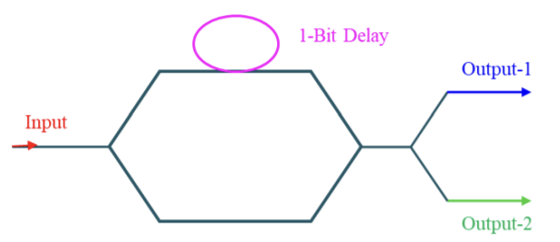
DPSK
Calculate the delay for a 40Gbps DPSK link at 1550nm. The refractive index of the waveguide is 1.6
The delay is the necessary path length difference.

